Slide 1

Supplemental Food Nutrition Assistance and Food Security
Kolby Porter

Slide 2
SNAP provides food benefits to low-income families to supplement their grocery budget so they can afford the nutritious food essential to health and well-being.
The idea for the first Food Stamp Program (FSP) is credited to various people, most notably Secretary of Agriculture Henry Wallace and the program's first Administrator Milo Perkins in 1939.

Slide 3
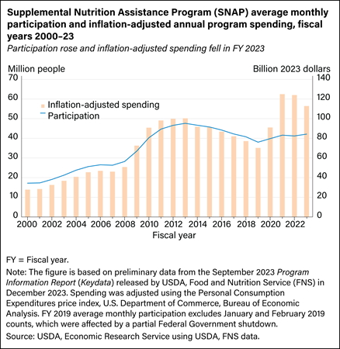
Historically
In FY 2023, SNAP served an average of 42.1 million participants per month. Federal SNAP spending totaled $112.8 billion and benefits averaged $211.93 per participant per month.

Slide 4
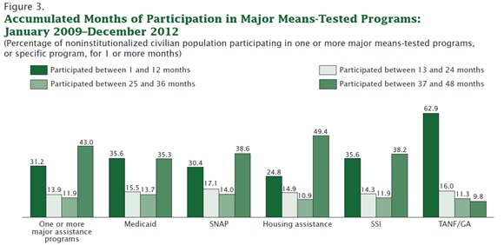
A longitudal study from the US Census Bureau shows the average length of participation in several assistance programs.
SNAP is currently designed to be a short-term relief program; the following analysis covers contemporaneous effect of SNAP participation on food security.

Slide 5
Data
Data for this study was appropriated from the US Census Bureau’s, Current Population Survey (CPS) – Food Security File, published December 2023.
The CPS has been conducted monthly for over 60 years.
Currently, they obtain interviews from about 54,000 households monthly, scientifically selected based on area of residence to represent the nation, individual states, and other specified areas.
The CPS provides current estimates of the economic status and activities of the population of the United States.

Slide 6
The CPS – Food Security dataset included 126,832 observations with 508 overlapping personal and household demographics. The following variables were used in my analysis.
HESP1 - Food Stamp participation (Treatment variable) 1 = Yes, 0 = No
HRFS12M1 - Food security from the last 12 months (Outcome variable) (Binary) 1 = Food Insecure, 0 = Food Secure
HEFAMINC - Family Income Levels
GEDIV - Geographic Region Indicator
PRNMCHLD - Respondents Number of Own Children in Household
PEMARITL - Respondents Marital Status
PEEDUCA - Respondents Education level
PTDTRACE - Respondents Race (Integrated Hispanic)
PENATVTY - Respondents Country of Birth
PEMLR - Respondents Labor Force Participation

Slide 7
Working Dataset
Cleaning
Handling
After removing observation that were not relevant to the previously mentioned variables, we were left with 25,879 observations.
Some respondents chose not to or were unable to accurately respond the survey questions regarding our variables.
Approximately 94,500 respondents were NIU
Categorical variables were standardized with stable reference categories (e.g., employed individuals, food-secure households) for clarity in interpretation.
Notes:
Food Stamp participation (SNAP participation) is generally asked at the household level, not the individual level. If the dataset contains responses for individuals, those who are not the household reference person may have "NIU" for this variable. For example: The CPS often selects one person (usually the household head) to answer household-level questions.
Other household members are considered "Not In Universe" (NIU) for questions like SNAP participation.

Slide 8
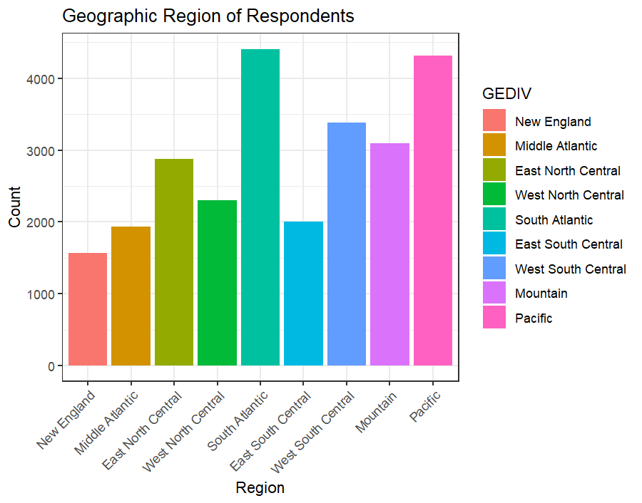
Demographics
GEDIV is the categorical variable indicating the respondent's geographic area.

Slide 9
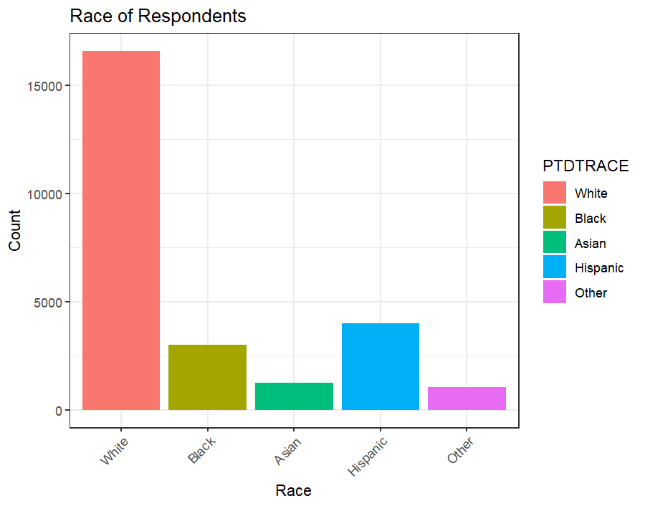
Demographics
The racial demographic of the respondent’s were capture in PTDRACE.

Slide 10
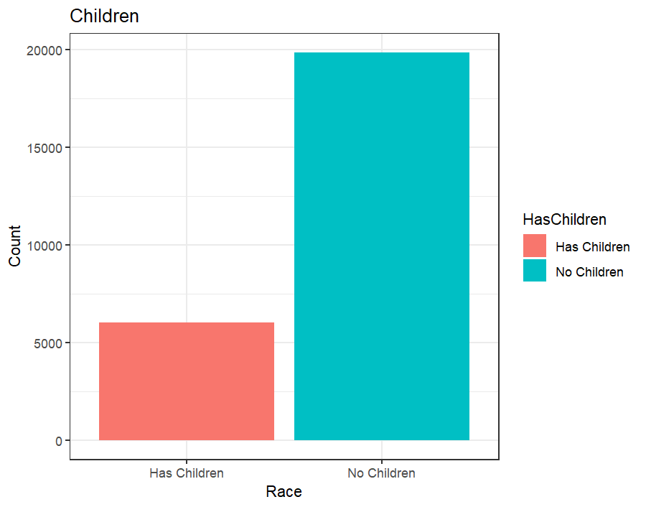
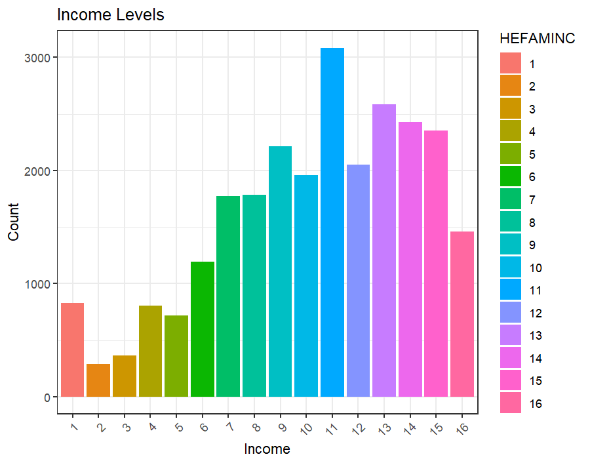

Slide 11
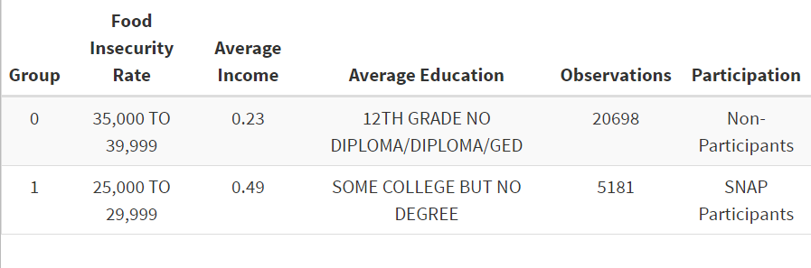
Demographics by Groups

Slide 12
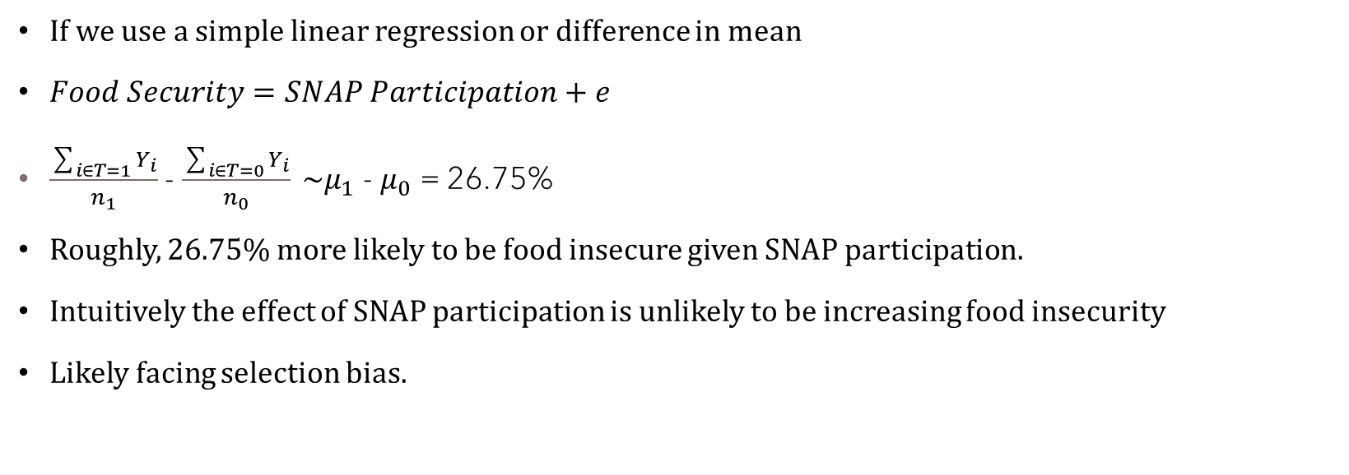
Analysis
If we use a simple linear regression or difference in mean
$Food Security=SNAP Participation+e$
$\frac{\sum_{i∈T=1}{Y_{i}}}{n_{1}}$- $\frac{\sum_{i∈T=0}{Y_{i}}}{n_{0}} \sim μ_{1}$ - $μ_{0}$ = 26.75%
Roughly, 26.75% more likely to be food insecure given SNAP participation.
Intuitively the effect of SNAP participation is unlikely to be increasing food insecurity
Likely facing selection bias.

Slide 13

Analysis
Using a linear regression with our covariates
$Food Security=β_{0}+\sum_{J=1}^{k}{β_{j}x_{ij}}+ε_{i}$
The coefficient for treatment ~20.5%
Still likely to be facing selection bias.

Slide 14


Analysis
Using separate linear regressions with our covariates and differencing the outcomes with 1000 bootstrap iterations.
${\hat{y}}_{i}^{\left(T\right)}=β_{0}^{\left(T\right)}+$ $\sum_{J=1}^{k}{β_{j}^{\left(T\right)}x_{ij}}+ε_{i}$
${\hat{y}}_{i}^{\left(U\right)}=β_{0}^{\left(U\right)}+$ $\sum_{J=1}^{k}{β_{j}^{\left(U\right)}x_{ij}}+ε_{i}$
${\hat{y}}_{i}^{\left(T\right)}−$ ${\hat{y}}_{i}^{\left(U\right)}$ = 0.207 ~20.7%

Slide 15


Addressing Selection Bias
We’ll use a logit model to analyze the dataset
$\left(P\left(y_{i}=1\right)\right)=\ln\left(\frac{P\left(y_{i}=1\right)}{1−P\left(y_{i}=1\right)}\right)=β_{0}+β_{1}{\left(T\right)}_{i}+\sum_{j=2}^{k}{β_{j}x_{ij}}$
The coefficient for the treatment variable from my model was 0.9492
The odds of food insecurity for SNAP participants are 2.58 times higher than for non-participants, holding all other factors constant.
The marginal effect of the treatment variable from the logit model was 0.1710

Slide 16
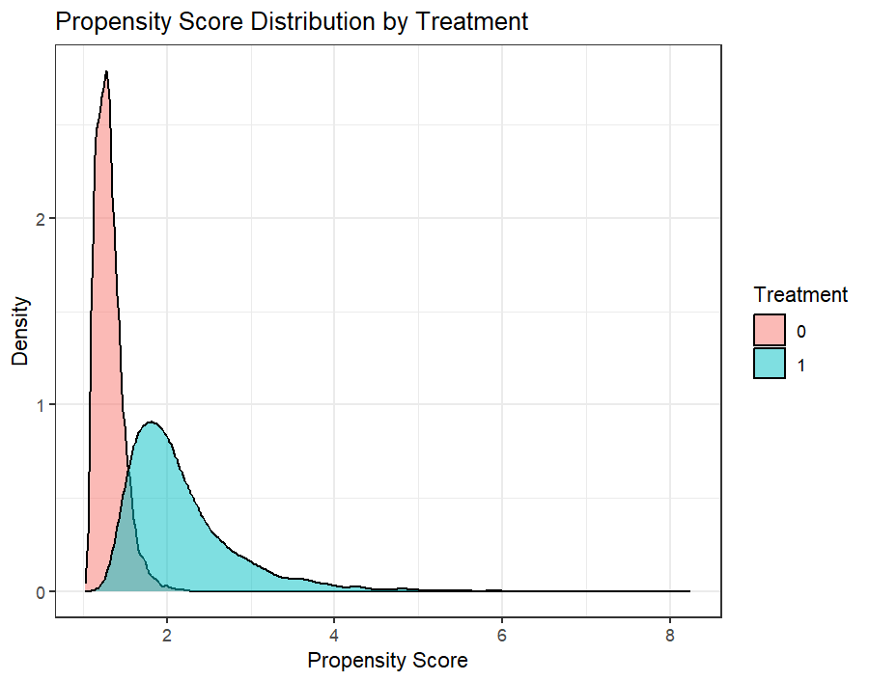
Propensity Scoring
We’ll use the logit fitted values to create propensity scores.
Difference in mean when using propensity scoring give an average treatment effect of -0.045
This translates to a 4.45% decrease in food insecurity given SNAP participation.
Bootstrap estimation of the ATE using propensity score weighting yields a coefficient of -0.046

Slide 17
Regression Adjustment
Performing regression adjustment using propensity score weighting yields a similar result.
Difference in mean when using regression adjustment yields an average treatment effect of -0.0242.
This translates to a 2.42% decrease in food insecurity given SNAP participation.

Slide 18
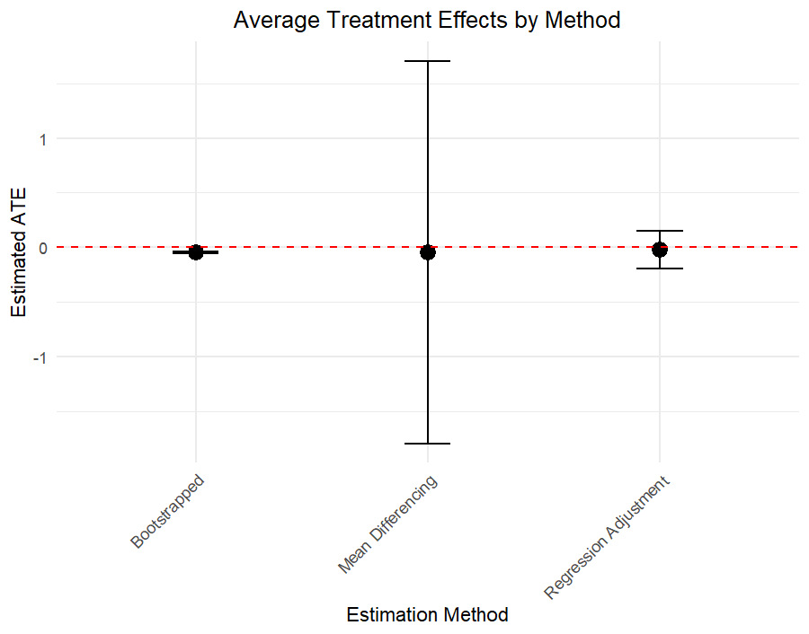
Evaluating ATEs
ATE Point Estimates:
All three methods show negative ATE values, indicating that SNAP participation reduces food insecurity.
The magnitude of the effects differs slightly between methods:
Bootstrapped shows a small negative ATE but is the most precise.
Mean Differencing is largely less precise but measured as negative.
Regression adjustment is a mix between the two.

Slide 19
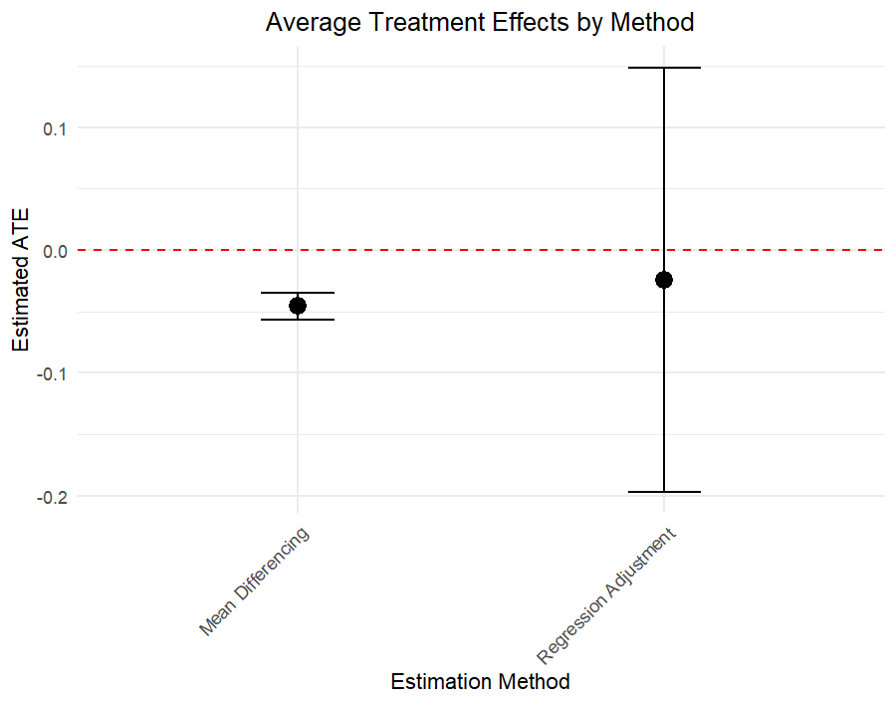
Evaluating ATEs
ATE Point Estimates:
All three methods show negative ATE values, indicating that SNAP participation reduces food insecurity.
The magnitude of the effects differs slightly between methods:
Bootstrapped shows a small negative ATE but is the most precise.
Mean Differencing is largely less precise but measured as negative.
Regression adjustment is a mix between the two.

Slide 20
Other Methods
The probit specification for the same model yielded a marginal effect of 0.1770 for the treatment variable
Sophisticated matching methods required subsetting the data due to the size of the data set. Simple nearest neighbor methods yielded coefficients closer to linear regression analysis than propensity scoring.

Slide 21
Evaluating The Analysis
(HESP1) Was a question eliciting an explicit response
“In the past 12 months, since December of last year, did (you/anyone in this household) get SNAP/Supplemental Nutrition Assistance Program or food stamp benefits?”
(HRFS12M1) Was a calculated classification based on several questions centered around recent situations that describe food insecurity e.g.,
“During the past 30 days, did any children in the household (between 5 and 18 years old) receive a free or reduced-price meal or snack at an afterschool program?”
The analysis performed was designed to measure the contemporaneous effects of SNAP participation and food security.
The Current Population Survey is largely based on direct input from respondents

Slide 22
Future Consideration
A more precise approach to answer this question may be using a longitudinal study. To truly derive a treatment effect a difference in differences model may present more applicable results.
Panel data from SNAP recipients
One could refine the analysis to measure food insecurity in areas with a higher cost of living.
Along with SNAP data, US BLS for cost-of-living data could be used to study the relationship between high-cost areas and food insecurity.

Slide 23
Questions?

